Slide 1
Topic 5 loop structures

Slide 2
CONTENTS
5.1 Definite and indefinite loops
5.2 Interactive loop and sentinel loop
5.3 End-of-file loop
5.4 Nested loop structures
5.5 Boolean algebra

Slide 3
Definite and indefinite loops
Program 4-4 (simple_loop1.py)
1 # This program demonstrates a simple for loop
2 # that uses a list of numbers.
3
4 print('I will display the numbers 1 through 5.')
5 for num in [1, 2, 3, 4, 5]:
6 print(num)
Program Output
I will display the numbers 1 through 5.
1
2
3
4
5
A definite loop, also known as a "for loop" or "count-controlled loop," is a type of loop where the number of iterations is predetermined or explicitly defined before the loop starts executing.
These loops are commonly used when you know the exact number of times you want to repeat a block of code.

Slide 4
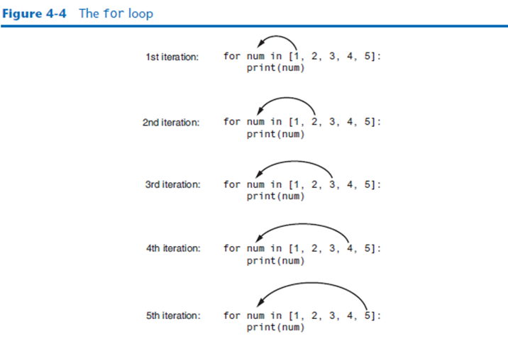

Slide 5
Program 4-5 (simple_loop2.py)
1 # This program also demonstrates a simple for
2 # loop that uses a list of numbers.
3
4 print('I will display the odd numbers 1 through 9.')
5 for num in [1, 3, 5, 7, 9]:
6 print(num)
Program Output
I will display the odd numbers 1 through 9.
1
3
5
7
9
Program 4-6 (simple_loop3.py)
1 # This program also demonstrates a simple for
2 # loop that uses a list of strings.
3
4 for name in ['Winken', 'Blinken', 'Nod']:
5 print(name)
Program Output
Winken
Blinken
Nod

Slide 6
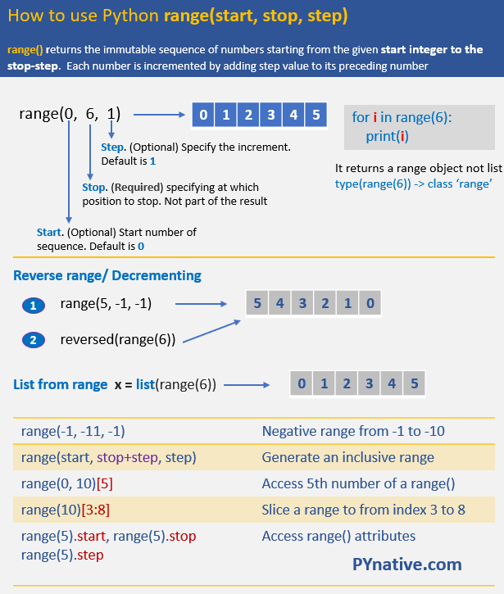

Slide 7
Using the range Function with the for Loop
Program 4-7 (simple_loop4.py)
1 # This program demonstrates how the range
2 # function can be used with a for loop.
3
4 # Print a message five times.
5 for x in range(5):
6 print('Hello world')
Program Output
Hello world
Hello world
Hello world
Hello world
Hello world

Slide 8
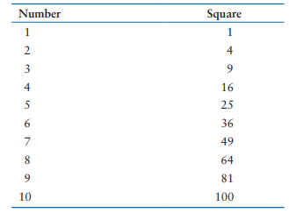
Using the Target Variable Inside the Loop
Program 4-8 (squares.py)
1 # This program uses a loop to display a
2 # table showing the numbers 1 through 10
3 # and their squares.
4
5 # Print the table headings.
6 print('Number\tSquare')
7 print('--------------')
8
9 # Print the numbers 1 through 10
10 # and their squares.
11 for number in range(1, 11):
12 square = number**2
13 print(f'{number}\t{square}')
Program Output
Number Square
---------------
1 1
2 4
3 9
4 16
5 25
6 36
7 49
8 64
9 81
10 100

Slide 9
(speed_converter.py)
1 # This program converts the speeds 60 kph
2 # through 130 kph (in 10 kph increments)
3 # to mph.
4
5 START_SPEED = 60 # Starting speed
6 END_SPEED = 131 # Ending speed
7 INCREMENT = 10 # Speed increment
8 CONVERSION_FACTOR = 0.6214 # Conversion factor
9
10 # Print the table headings.
11 print('KPH\tMPH')
12 print('--------------')
13
14 # Print the speeds.
15 for kph in range(START_SPEED, END_SPEED, INCREMENT)
16 mph = kph * CONVERSION_FACTOR
17 print(f'{kph}\t{mph:.1f}')
Program Output
KPH MPH
----------------
60 37.3
70 43.5
80 49.7
90 55.9
100 62.1
110 68.4
120 74.6
130 80.8

Slide 10
Sentinels
1 # This program displays property taxes.
2
3 TAX_FACTOR = 0.0065 # Represents the tax factor
5 # Get the first lot number.
6 print('Enter the property lot number or enter 0 to end.')
7 lot = int(input('Lot number: '))
8
9 # Continue processing as long as the user
10 # does not enter lot number 0.
11 while lot != 0:
12 # Get the property value.
13 value = float(input('Enter the property value: '))
14
15 # Calculate the property's tax.
16 tax = value * TAX_FACTOR
17
18 # Display the tax.
19 print(f'Property tax: ${tax:,.2f}')
20
21 # Get the next lot number.
22 print('Enter the next lot number or enter 0 to end.')
23 lot = int(input('Lot number: '))
A sentinel is a special value that marks the end of a sequence of items.
When a program reads the sentinel value, it knows it has reached the end of the sequence, so the loop terminates
Program Output (with input shown in bold)
Enter the property lot number or enter 0 to end.
Lot number: 100
Enter the property value: 100000.00
Property tax: $650.00.
Enter the next lot number or enter 0 to end.
Lot number: 200
Enter the property value: 5000.00
Property tax: $32.50.
Enter the next lot number or enter 0 to end.
Lot number: 0

Slide 11
Input Validation Loops
Input validation is the process of inspecting data that has been input to a program, to make sure it is valid before it is used in a computation.
Input validation is commonly done with a loop that iterates as long as an input variable references bad data

Slide 12
1 # This program calculates retail prices.
2 MARK_UP = 2.5 # The markup percentage
3 another = 'y' # Variable to control the loop.
4
5 # Process one or more items.
6 while another == 'y' or another == 'Y':
7 # Get the item's wholesale cost.
8 wholesale = float(input("Enter the item's wholesale cost: "))
9
10 # Calculate the retail price.
11 retail = wholesale * MARK_UP
12
13 # Display the retail price.
14 print(f'Retail price: ${retail:,.2f}')
15
16 # Do this again?
17 another = input('Do you have another item? ' +
18 '(Enter y for yes): ')
Program Output (with input shown in bold)
Enter the item's wholesale cost: 10.00
Retail price: $25.00
Do you have another item? (Enter y for yes): y
Enter the item's wholesale cost: 15.00
Retail price: $37.50
Do you have another item? (Enter y for yes): y
Enter the item's wholesale cost: 12.50 Enter
Retail price: $31.25
Do you have another item? (Enter y for yes): n
v

Slide 13
1 # This program calculates retail prices.
2 MARK_UP = 2.5 # The markup percentage
3 another = 'y' # Variable to control the loop.
4
5 # Process one or more items.
6 while another == 'y' or another == 'Y':
7 # Get the item's wholesale cost.
8 wholesale = float(input("Enter the item's wholesale cost: "))
9
10 # Validate the wholesale cost.
11 while wholesale < 0:
12 print('ERROR: the cost cannot be negative.')
13 wholesale = float(input('Enter the correct ' +
14 'wholesale cost: '))
15
16 # Calculate the retail price.
17 retail = wholesale * MARK_UP
18
19 # Display the retail price.
20 print(f'Retail price: ${retail:,.2f}')
21
22
23 # Do this again?
24 another = input('Do you have another item? ' +
25 '(Enter y for yes): ')
Program Output (with input shown in bold)
Enter the item's wholesale cost: −.50
ERROR: the cost cannot be negative.
Enter the correct wholesale cost: 0.50
Retail price: $1.25
Do you have another item? (Enter y for yes): n

Slide 14
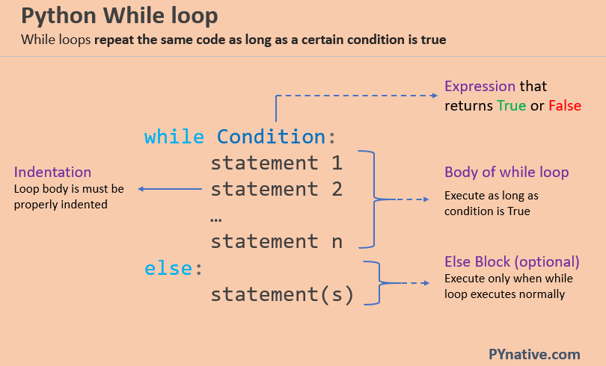

Slide 15
number = int(input('Enter any number between 100 and 500 '))
# number greater than 100 and less than 500
while number < 100 or number > 500:
print('Incorrect number, Please enter correct number:')
number = int(input('Enter a Number between 100 and 500 '))
else:
print("Given Number is correct", number)
Enter any number between 100 and 500 700
Incorrect number, Please enter correct number:
Enter a Number between 100 and 500 98
Incorrect number, Please enter correct number:
Enter a Number between 100 and 500 300
Given Number is correct 300

Slide 16
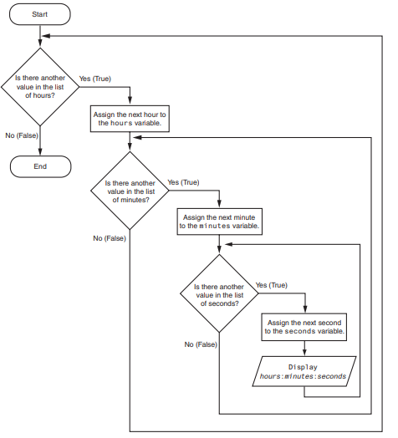
Nested Loops
A loop that is inside another loop is called a nested loop

Slide 17
(test_score_averages.py)
1 # This program averages test scores. It asks the user for the
2 # number of students and the number of test scores per student.
3
4 # Get the number of students.
5 num_students = int(input('How many students do you have? '))
6
7 # Get the number of test scores per student.
8 num_test_scores = int(input('How many test scores per student? '))
9
10 # Determine each student's average test score.
11 for student in range(num_students):
12 # Initialize an accumulator for the test scores.
13 total = 0.0
14
15 # Display the student number.
16 print(f'Student number {student + 1}')
17 print('-----------------')
18
19 # Get the student's test scores.
20 for test_num in range(num_test_scores):
21 print(f'Test number {test_num + 1}', end='')
22 score = float(input(': '))
23
24 # Add the score to the accumulator.
25 total += score
26
27 # Calculate the average test score for this student.
28 average = total / num_test_scores
29
30 # Display the average.
31 print(f'The average for student number {student + 1} '
32 f'is: {average:.1f}')
33 print()
Program Output (with input shown in bold)
How many students do you have? 3
How many test scores per student? 3
M04_GADD8637_05_GE_C04.indd 224 24/04/2021 12:29
Student number 1
–––––––––––––––––
Test number 1: 100
Test number 2: 95
Test number 3: 90
The average for student number 1 is: 95.0
Student number 2
–––––––––––––––––
Test number 1: 80
Test number 2: 81
Test number 3: 82
The average for student number 2 is: 81.0
Student number 3
–––––––––––––––––
Test number 1: 75
Test number 2: 85
Test number 3: 80
The average for student number 3 is: 80.0

Slide 18
1 * 1 = 1
1 * 2 = 2
1 * 3 = 3
1 * 4 = 4
1 * 5 = 5
1 * 6 = 6
1 * 7 = 7
1 * 8 = 8
1 * 9 = 9
1 * 10 = 10
2 * 1 = 2
2 * 2 = 4
2 * 3 = 6
2 * 4 = 8
2 * 5 = 10
2 * 6 = 12
2 * 7 = 14
2 * 8 = 16
2 * 9 = 18
2 * 10 = 20
3 * 1 = 3
3 * 2 = 6
3 * 3 = 9
3 * 4 = 12
3 * 5 = 15
3 * 6 = 18
3 * 7 = 21
3 * 8 = 24
3 * 9 = 27
3 * 10 = 30
4 * 1 = 4
4 * 2 = 8
4 * 3 = 12
4 * 4 = 16
4 * 5 = 20
4 * 6 = 24
4 * 7 = 28
4 * 8 = 32
4 * 9 = 36
4 * 10 = 40
5 * 1 = 5
5 * 2 = 10
5 * 3 = 15
5 * 4 = 20
5 * 5 = 25
5 * 6 = 30
5 * 7 = 35
5 * 8 = 40
5 * 9 = 45
5 * 10 = 50
for i in range(1, 6): # Outer loop for rows (1 to 5)
for j in range(1, 11): # Inner loop for columns (1 to 10)
product = i * j
print(f"{i} * {j} = {product}")
print() # Print an empty line after each row

Slide 19
THANK YOU
ANY QUESTION?

